Slide 1
Automatic Sun Tracking System
(Using Arduino UNO)
112007017 Prajwal Deshmukh
112007018 Ram Dhalpe
112007019 Mithil Dharmik
112007020 Guruprasad Dhore

Slide 2

Solar panels are becoming more popular day by day.The position of the Sun with respect to the solar panel is not fixed due to the rotation of the Earth. For an efficient usage of the solar energy, the Solar panels should absorb energy to a maximum extent.This can be done only if the panels are continuously placed towards the direction of the Sun. So, solar panel should continuously rotate in the direction of Sun. This article describes about circuit that rotates solar panel.

Slide 3
PRINCIPAL OF SOLAR TRACKING PANEL
Two light dependent resistors are arranged on the edges of the solar panel. Light dependent resistors produce low resistance when light falls on them. The servo motor connected to the panel rotates the panel in the direction of Sun. Panel is arranged in such a way that light on two LDRs is compared, and panel is rotated towards LDR which have high intensity i.e., low resistance compared to other. Servo motor rotates the panel at certain angle.
When the intensity of the light falling on right LDR is more, panel slowly moves towards right and if intensity on the left LDR is more, panel slowly moves towards left. In the noon time, Sun is ahead and intensity of light on both the panels is same. In such cases, panel is constant and there is no rotation.

Slide 4

Components used :-
1.Solar panel
Solar panels use sunlight as a source of energy to generate direct current electricity.

Slide 5
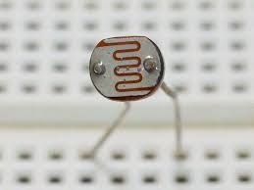
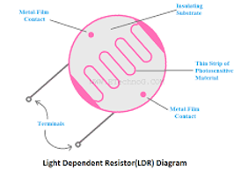
2. LDR
Light Dependent resistors are electronic components that are used to detect light& change the operation of the circuit dependent upon the light levels.

Slide 6
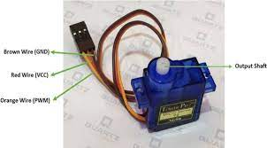
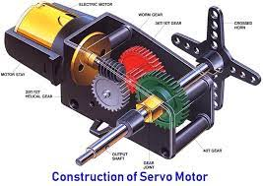
3.Servo Motor
A servo motor is a rotary actuator that allows for precise control of angular position. It consists of a motor coupled to a sensor for position feedback. It also requires a servo drive to complete the system.

Slide 7
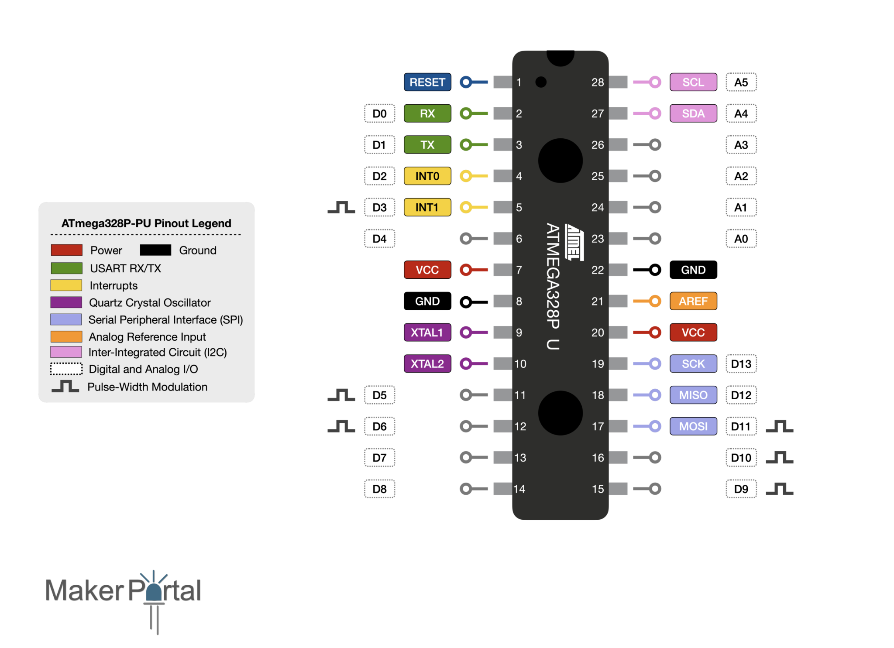
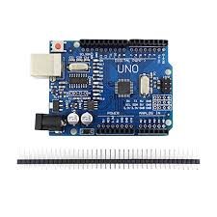
4.ATMega328 Microcontroller
The Atmel ATmega328P is a low-power CMOS 8-bit microcontroller based on the AVR enhanced RISC architecture. By
executing powerful instructions in a single clock cycle, the ATmega328P achieves throughputs approaching 1MIPS per MHz allowing the system designer to optimize power consumption versus processing speed.

Slide 8
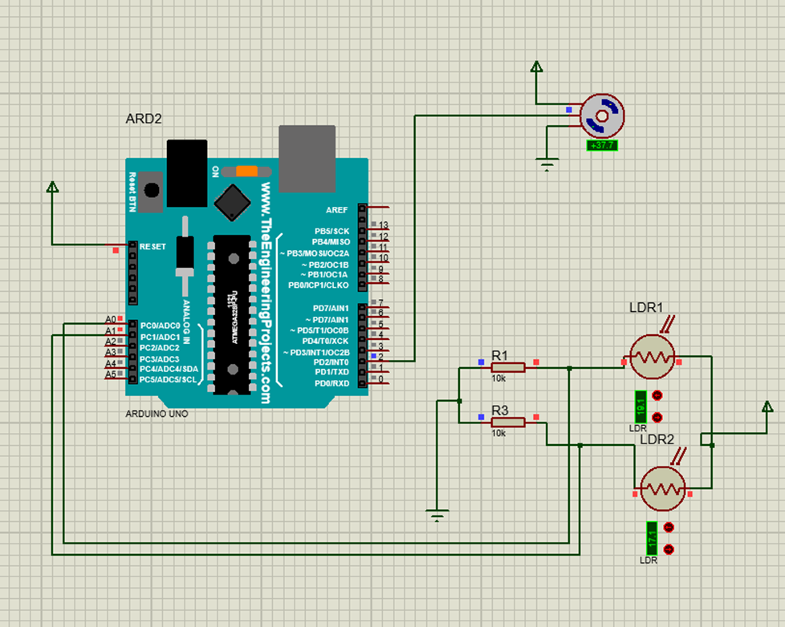
Schematic of working model :-

Slide 9
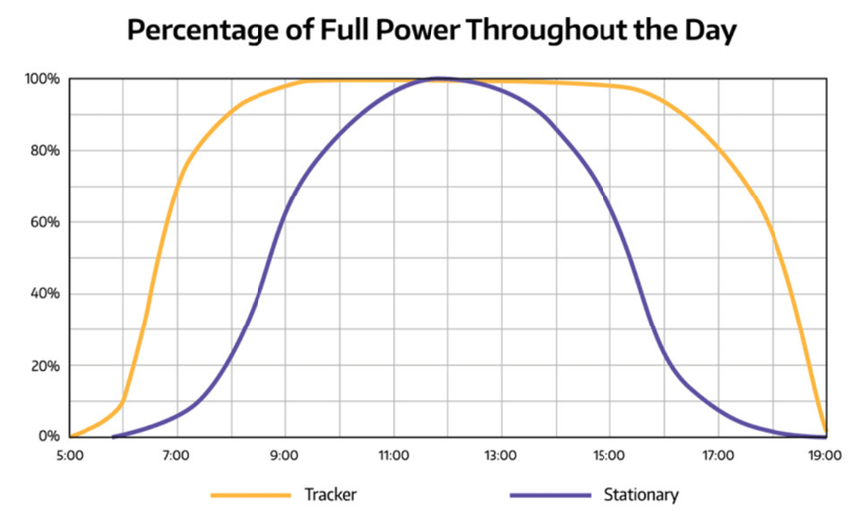

Slide 10
